Slide 1
IBM University Engagement Project Submission
“Exploring the Power of Agentic AI with IBM Granite and LangFlow”

Slide 2

Project Tile – Interview Trainer Agent
Domain of Project – Education
Student Name | Recent Passport Photo | Email ID | Mobile number [WhatsApp]
Konatham Manasa |  | vr2768525@gmail.com | 8498026913

Slide 3
Problem Statement -
Problem Statement : Interview Trainer Agent
The Challenge
Many students and job seekers find it difficult to prepare for interviews due to lack of practice, confidence, and proper feedback. Traditional preparation methods do not provide real-time evaluation or personalized suggestions for improvement.
The Objective
Develop an Interview Trainer Agent that:
Simulates real interview scenarios
Asks relevant technical and HR questions
Evaluates user responses
Provides structured feedback
Helps users improve communication and problem-solving skills

Slide 4
Technology Used
Tech Stack (Mandatory)
IBM Watsonx Orchestrate + IBM Granite Models + IBM Cloud

Slide 5
Proposed Solution -
Proposed Solution: AI-Interview Trainer Agent
The Interview Trainer Agent is designed to simulate real interview environments using IBM Watsonx Orchestrate and Granite models. It interacts with users by asking interview questions based on selected roles and difficulty levels.
The system evaluates user responses in real time and provides structured feedback, including scores, strengths, weaknesses, and suggestions for improvement.
It also uses resume-based question generation to make interviews more personalized and relevant. The agent adapts dynamically to user performance, ensuring continuous learning and skill enhancement.

Slide 6
Orchestrate component Used -
1) User Input Interface – Accepts user responses during the interview.
2) Interview Agent (Watsonx Orchestrate) – Controls the interview flow and interaction.
3) IBM Granite Model – Generates questions and evaluates answers.
4) Chat Output Interface – Displays questions, feedback, and scores.
5) Response Evaluation Component – Analyzes answers and provides structured feedback.
6) Prompt Engineering Component – Controls question generation and evaluation logic.

Slide 7
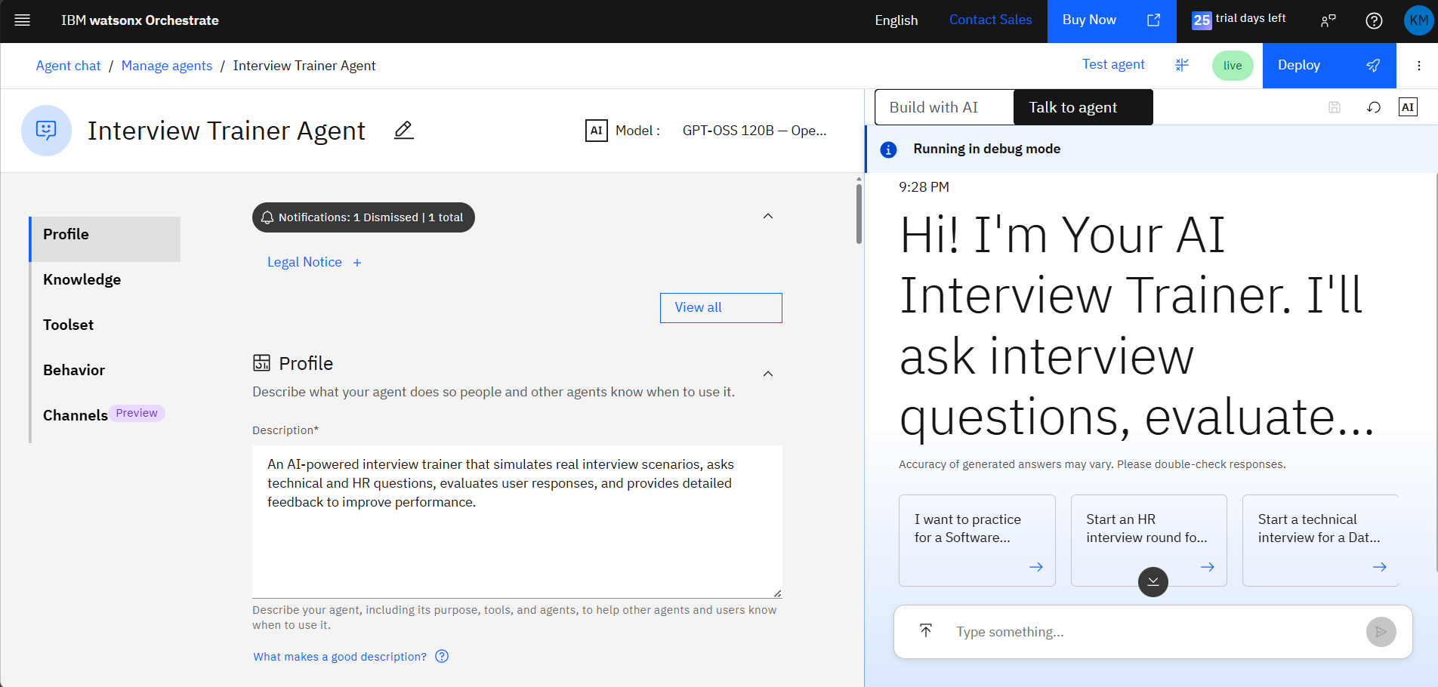
Interview Agent Workflow (Watsonx Orchestrate)-
1. User starts the interview session
2. The Interview Agent generates and asks question
3. User submits their response
4. IBM Granite model evaluates the answer
5. System generates feedback and score
6. Agent asks the next question
7. Final performance summary is provided

Slide 8
System Architecture
User (Chat Interface)
↓
IBM Watsonx Orchestrate Agent
↓
IBM Granite Model
↓
Prompt Engineering Logic
↓
Response Evaluation
↓
Feedback Output (Score + Suggestions)

Slide 9

Role of Agentic AI in the solution
Role of Agentic AI in Interview Trainer Agent
Agentic AI enables the system to act as an intelligent interviewer rather than a simple chatbot.
The agent independently:
- Generates interview questions
- Evaluates user responses
- Provides structured feedback
It adapts based on user performance, making the interview dynamic and personalized.
This creates a real interview-like experience and helps users improve continuously.

Slide 10
Technology Used
IBM Watsonx Orchestrate – Used to build and manage the interview agent
IBM Granite Model – Used for question generation and answer evaluation
IBM Cloud – Platform for deployment and execution
Prompt Engineering – Defines logic for responses and evaluation
Knowledge Source – Resume-based personalization (if used)

Slide 11
Novelty and Uniqueness
The Interview Trainer Agent stands out by using Agentic AI to simulate a real interview experience instead of a simple question-answer system.
- AI-Based Interview Simulation – Acts like a real interviewer by asking dynamic and context-aware questions.
- Real-Time Response Evaluation – Provides instant feedback, scoring, and improvement suggestions.
- Adaptive Questioning – Adjusts question difficulty based on user performance.
- Personalized Interaction – Can generate questions based on user role or background.
- No Static Dataset Required – Uses IBM Granite models for dynamic question generation and evaluation.
- Continuous Learning Experience – Helps users improve confidence and communication skills through repeated practice.
This makes the system an intelligent and interactive interview coach rather than a static preparation tool.

Slide 12
Git Hub Link
Git Hub URL- https://github.com/KonathamManasa/Interview-trainer-agent.git
·
·
·

Slide 13
Future Scope
1. Voice-Based Interview Interaction –
Enable users to practice interviews using voice for a more realistic experience.
2. Web-Based User Interface –
Develop a complete web or mobile application for better usability.
3. Multi-Language Support –
Allow interviews in multiple languages to support diverse users.
4. Advanced Performance Analytics –
Provide detailed reports and progress tracking to improve user performance over time.
·
·
·

Slide 14


